Slide 1


A
Presentation on
IoT Based Alert System
Votary Softech Solution Pvt. Ltd.
- By Rathod Rajiv V.
Votary Softech Solutions Pvt. Ltd.| Copyright ©2017| Confidential
Notes:
1

Slide 2
Contents
Objective
Architecture & Design Diagram
Project Description
Roles and Responsibility

Slide 3
Objective
The main objective of this project is, to trigger the status of build process via alarm or flash screen.

Slide 4
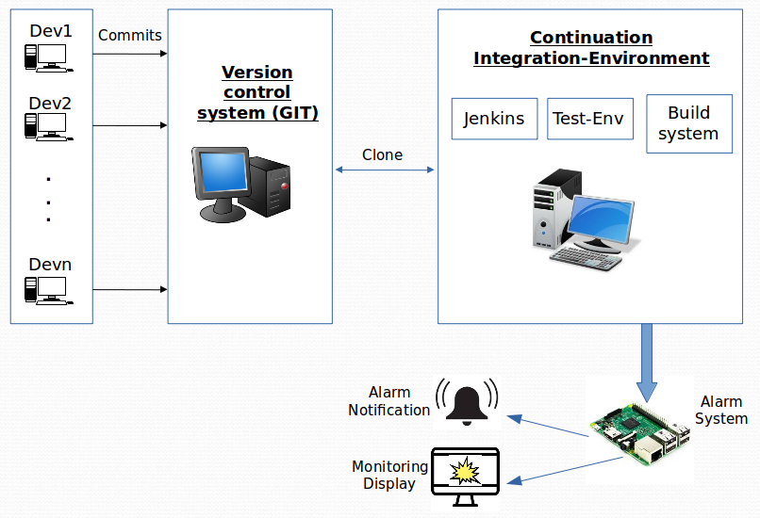
Architecture & Design Diagram

Slide 5
Project Description
Whenever modified source code pushing to the Git server, Jenkin tool will detect that checkin and it will start building automatically.
If build is fail or success, Jenkin tool will send the notification to remote device via e-mail.
If the status of received e-email is ‘Build fail’, then it will trigger the alarm.
The main purpose to send notification is, to alert the people who are monitoring continuous build and integration process. The alart is via sound or flash on the screen.

Slide 6
Roles & Responsibility
Setup of Git Server
Installation & Configuration of Jenkin
Python Script for e-mail configuartion
Written test cases
Manual Testing for Product

Slide 7
Thanks

